Slide 1
Modification Point Aware Test Prioritization and Sampling to Improve Patch Validation in Automatic Program Repair
Yazhini Venugopal , Phung Quang-Ngoc and Lee Eunseok
2020-06-04
JuHyoung Kim
kjhkjh75@naver.com

Slide 2
- Introduction
Increasing in software complexity
-> time-consuming and tedious.
To reduce manual efforts in testing
-> APR
Two approaches to APR
1. Generate and Validate
2. Semantic-driven
Validation test consume a lot of time and cost.
-> Need prioritization.

Slide 3
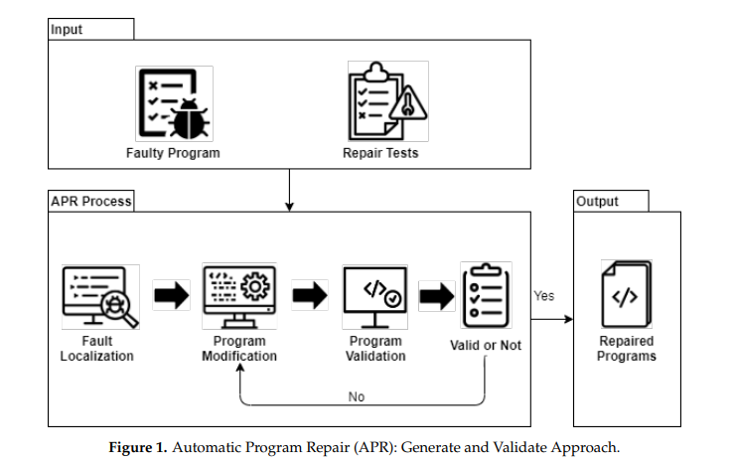
- Background
APR

Slide 4
- Background
Test Case Prioritization and Sampling.
- In this paper, use fault-based prioritization.
- FPRT(Fault-Recorded Testing Prioritization) –Based work.
-> Does not require any previous execution of test cases.
-> Ranks the test cases based on the failing test cases, which helps
in early incorrect patch detection.

Slide 5
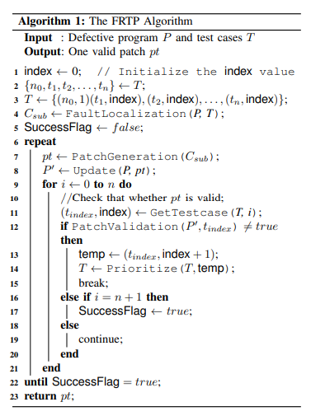
- Background

Slide 6
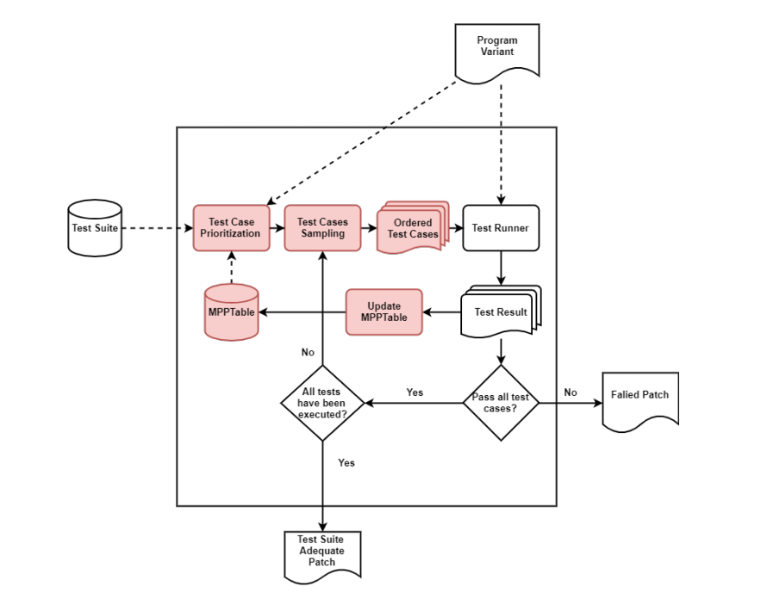
- Proposed Method
Proposed Method

Slide 7
- Proposed Method
Proposed Method
- Split the test suite into multiple subsets.
- Executed one by one until the last subset, if there are no failing test
- If all the subsets pass, it is delivered as a Test suite Adequate patch
- Otherwise, Test Runner will be stopped after completely executing
-> Outcome is considered a Failed patch.
- The fitness score is calculated for the patch and based on the score
- Failed patch undergo modification once again.

Slide 8
- Proposed Method
Proposed Method
- During validation, every program variant, modification point information, related test cases, and its failing count are mapped in a table
- Record that information to calculate the patch killing count of a test case
- Each subset have an equal number of test cases (20)
- If all test cases in the subset passed against the program variant,
-> next set will be executed.

Slide 9
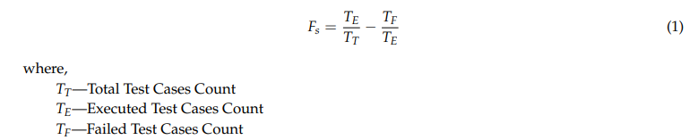
- Proposed Method
New fitness Function.

Slide 10
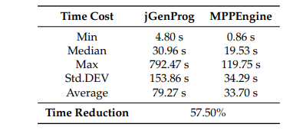
- Result
RQ1. Effectiveness of MPPEngine against jGenProg in terms of reducing test execution time and cost

Slide 11
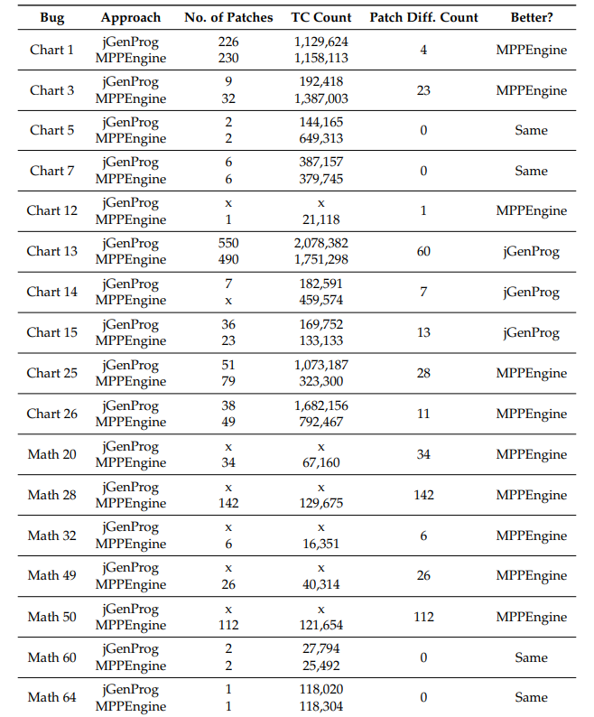
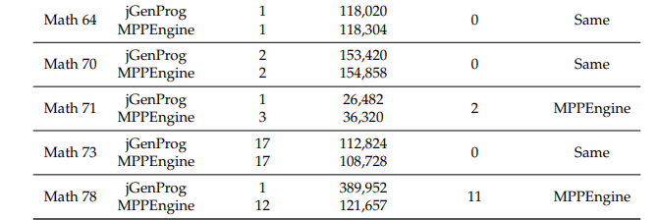
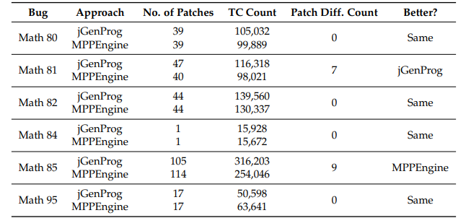
- Result
RQ2. MPPEngine Produce More Patches for Bugs Compared to jGenProg?

Slide 12
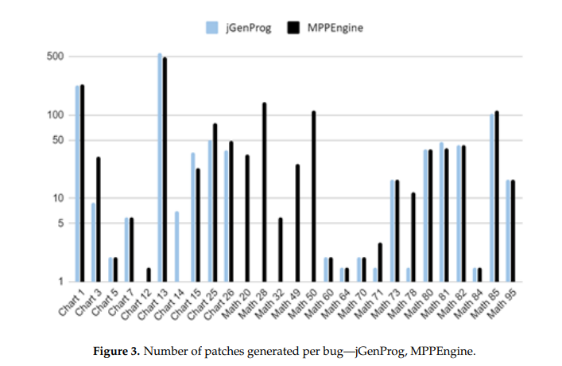
- Result
RQ3: Is There Any New Patch Generated for Bugs by MPPEngine for Which jGenProg Does Not Produce Any Solution?

Slide 13
- Limit
Ideal
- Before first time modification, Set the prioritization.
Reality
- Construct subset not only quantitative calculation, but also qualitatively
- As I can, separate the test case not similar (how..)
->it mean one subset take large coverage

Slide 14
- Future work
Separate subset maximize the coverage the codes.
Include the previous result feedback

Slide 15
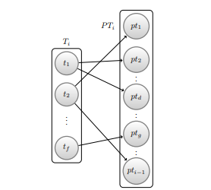
- Future work
Calculate the similarity among patch candidate and before candidates.
Give prioritize score the test suite similar candidate`s fail case.sd

